Slide 1
Introduction to Cloud Computing
Notes:
Day - 1
Duration -120 Mins
Mode of delivery : Instructor Lead

Slide 2
At the core of this lesson
You will learn
Building Blocks of Digital world
Basic Computing Technology
Servers and Data centers
Virtual Machine
Introduction to cloud computing

Slide 3
Building Blocks of Digital world
1.Computers
2. Data
3. Internet
4.Software
5. Algorithms
Notes:
Chapter -1 Day -1 Building Blocks of Digital world
Computers: Computers form the foundation of the digital world. They are electronic devices that process and store digital information using binary code (0s and 1s). Computers come in various forms, including personal computers, laptops, servers, and mobile devices.
Internet: The internet is a global network that connects computers and allows them to communicate and share information.
Data: Data is at the core of the digital world. It refers to the raw facts, figures, and symbols that represent information.
Software: Software refers to the programs, applications, and operating systems that run on computers and other digital devices.
Algorithms: Algorithms are step-by-step procedures or sets of rules used to solve problems or perform calculations.

Slide 4
6. Networks
7. Cloud Computing
8. Cyber security
9. IOT
10. Internet of Things(IOT)
Notes:
Networks: Networks are the infrastructure that connects computers and other devices to facilitate communication and data transfer.
Cloud Computing: Cloud computing allows the storage, processing, and access of data and applications over the internet, without requiring local infrastructure.
Cybersecurity: Cybersecurity measures are essential to protect digital systems and information from unauthorized access, data breaches, and other malicious activities.
Internet of Things (IoT): The IoT refers to the network of interconnected physical devices embedded with sensors, software, and connectivity, enabling them to collect and exchange data.
Artificial Intelligence (AI): AI encompasses technologies that enable machines to simulate human intelligence, learn from data, and perform tasks that typically require human cognitive abilities.

Slide 5
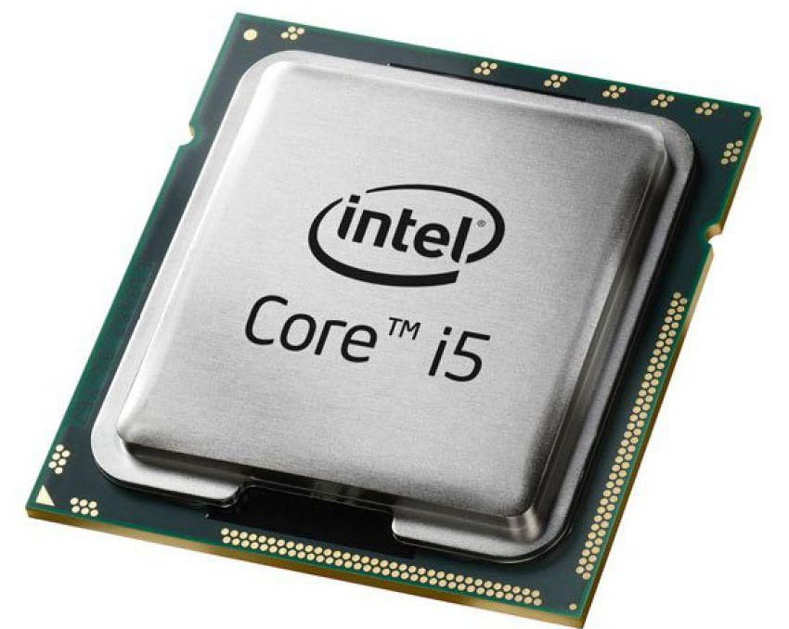
Basic Computing Terminology
Hardware / Software
Operating System
Components of computer
e.g. memory, processor, storage & Peripherals
Processor :
A processor, also known as a central processing unit (CPU), is a crucial component of a computer or electronic device. It serves as the brain of the system, responsible for executing instructions and performing calculations required for the device to function.
Notes:
Hardware : A set of physical components ( Electronic, Electrical, Mechanical and Magnetic devices)
Software : Set of programs is called software.
Program : Set of Instructions is called program.
OS(Operating system) : It is a system software which is used to interconnect between user and the machine.

Slide 6
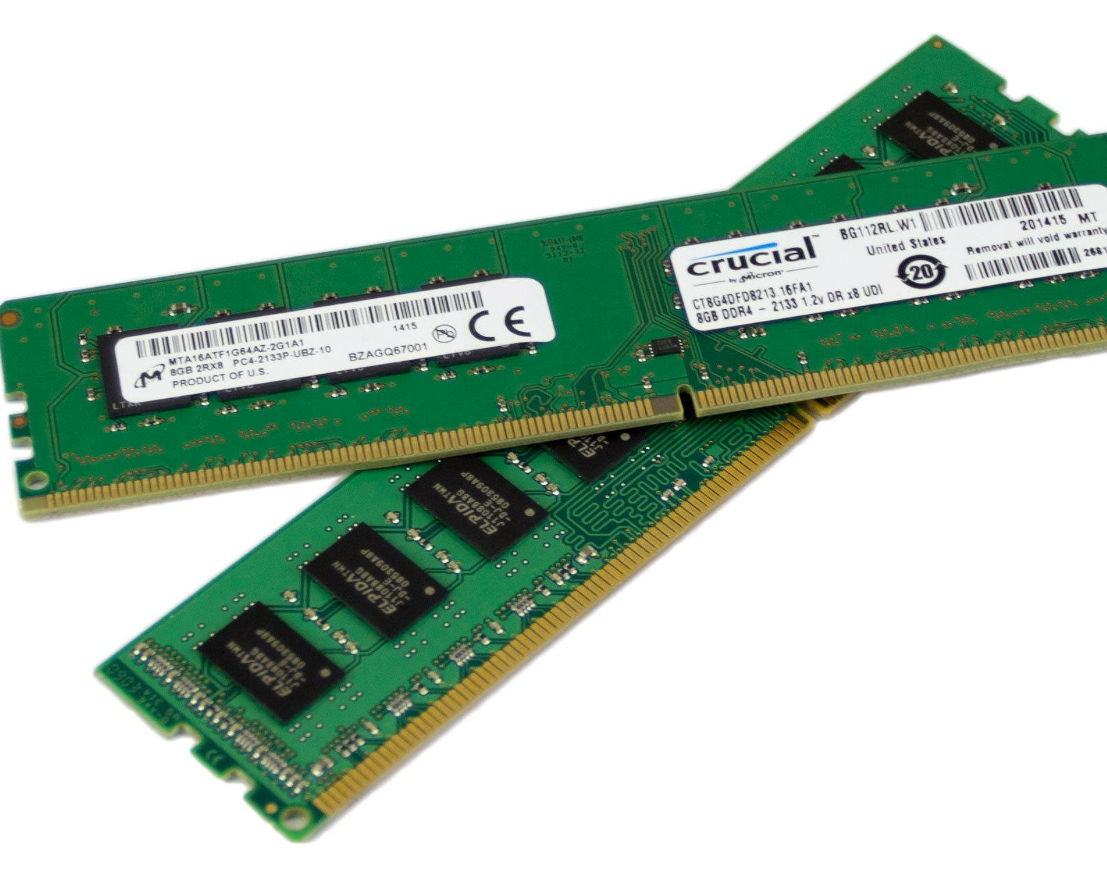
Main memory(RAM)
Main memory, also known as primary memory or random-access memory (RAM), is a type of computer memory that provides fast and temporary storage for data and instructions that are actively being processed by the central processing unit (CPU).
Main memory is directly accessible by the CPU, allowing for rapid data retrieval and storage. It is used to hold the operating system, applications, and data that are currently in use.
Notes:
Chapter – 1 Main Memory

Slide 7
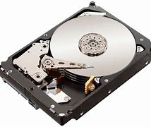
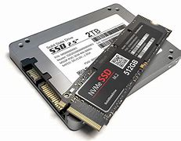
Storage Devices
HDD (Hard disk Drive)
SSD ( Solid State Drive)
Optical Drives( Compact Disk & DVD )
USB ( Universal serial Bus )
Notes:
Chapter – 1 Storage devices
Hard Disk Drive (HDD): HDDs are magnetic storage devices that use rotating platters with magnetic coatings and read/write heads to store and retrieve data.
Solid-State Drive (SSD): SSDs are storage devices that use flash memory technology to store data.
Optical Drives: Optical drives use laser technology to read and write data on optical discs, such as CDs, DVDs, and Blu-ray discs.
USB Flash Drives: USB flash drives, also known as thumb drives or pen drives, are portable storage devices that use flash memory to store data.

Slide 8
Software & Types of Software
Software
Software refers to a collection of programs, data, and instructions that enable a computer or electronic device to perform specific tasks or operations.
Different types of Software
Application - used to fulfil user needs. E.g. CRM software, banking application, employee pay bill etc.
System Software - used to control computer hardware
Notes:
Chapter – 1 Types of software
Application software : Application software refers to programs designed to perform specific tasks or provide specific functionalities for end-users.
System software : System software is responsible for managing and controlling the hardware resources of a computer system. It provides a platform for other software applications to run.
Examples of system software include:
Operating Systems (OS)
Device Drivers
Utility Software

Slide 9
Servers & Clients
What is a server & client machines
Server
is a large-scale machine used to perform client request
Has two or more processors
More memory
More storage – two or more hard disks
Server can respond to two or more client requests at any given time
Client machine
Sends a request to the server
Notes:
Server : A server is a computer or system that provides services or resources to other computers or devices, referred to as clients, over a network. It is designed to handle and respond to requests from clients, fulfilling their needs for data, processing power, storage, or other resources.
Clients :

Slide 10
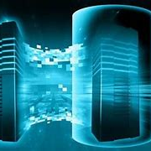
Server Types
There are various types of servers, each serving specific purposes or providing particular services. Some common types include:
File Servers
Web Servers
Database Servers
Application Servers
Mail Servers
Notes:
File Servers: Store and provide access to files and data for clients over a network. They facilitate file sharing and centralized data storage.
Web Servers: Host websites and deliver web pages and content to clients via the Hypertext Transfer Protocol (HTTP).
Database Servers: Store and manage databases, allowing clients to store, retrieve, and manipulate data efficiently.
Application Servers: Run and manage applications and provide the necessary environment for their execution.
Mail Servers: Handle email communication, sending, receiving, and storing emails on behalf of clients.

Slide 11
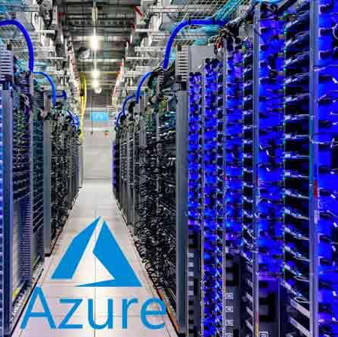
Data center
A data center is a specialized facility or building that houses a large number of computer servers, storage systems, networking equipment, and other infrastructure components required for the storage, management, and processing of data.
Notes:
Here are some key characteristics and components of data centers:
Infrastructure: Data centers are equipped with a range of infrastructure elements to support the operations of the housed equipment. This includes power supply systems, cooling systems, backup generators, uninterruptible power supply (UPS) units, and fire suppression systems.
Server Racks and Cabinets: Data centers organize servers and networking equipment in racks or cabinets, which provide physical support, cable management, and easy access for maintenance and upgrades.
Networking and Connectivity: Data centers have robust networking infrastructure to ensure fast and reliable connectivity.
Cooling Systems: Data centers generate significant heat due to the large number of servers and equipment operating in a confined space. Cooling systems, such as air conditioning, precision cooling units.
Power Supply and Backup: Data centers require a reliable power supply to ensure uninterrupted operations.
Data Storage and Management: Data centers often have large-scale storage systems, such as disk arrays or solid-state drives, to store vast amounts of data.

Slide 12
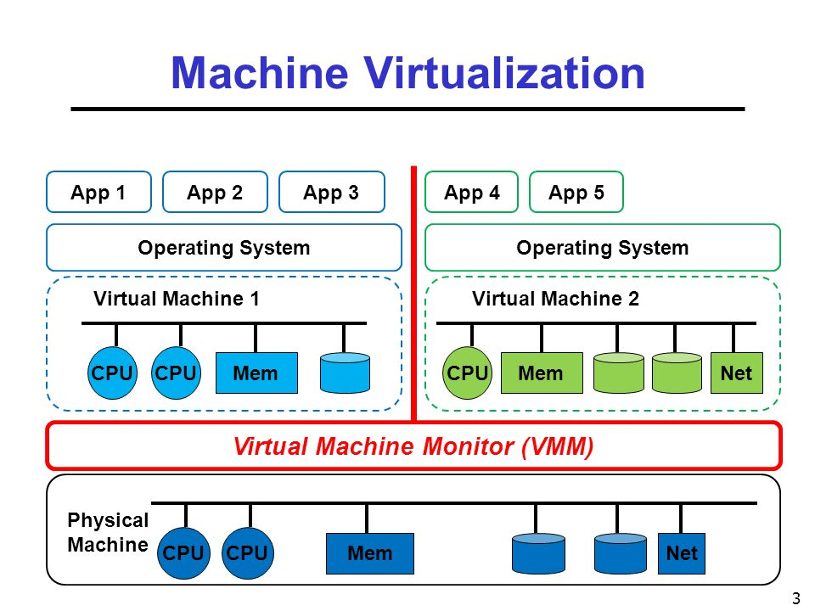
Virtualization
Virtualization
Virtualization is a technology that allows for the creation of virtual instances or representations of physical resources, such as servers, operating systems, storage devices, or network resources.
virtual machine
Virtual machines are complete, self-contained instances of operating systems and applications running within a virtualized environment. Each VM has its own virtualized hardware, including virtual CPUs, memory, storage, and network interfaces.
Notes:
key concepts and components of virtualization:
Hypervisor: A hypervisor, also known as a virtual machine monitor (VMM), is software or firmware that enables the creation and management of virtual machines. It abstracts the underlying physical hardware and allows multiple VMs to run concurrently on the same host system. The hypervisor controls the allocation of resources, manages communication between VMs and the host, and ensures isolation and security among the guests.
Host and Guest: In virtualization, a physical server or system is referred to as the "host," while the virtual instances running on the host are called "guests" or "virtual machines" (VMs). The host system provides the necessary resources, such as processing power, memory, and storage, for the guests to operate.

Slide 13
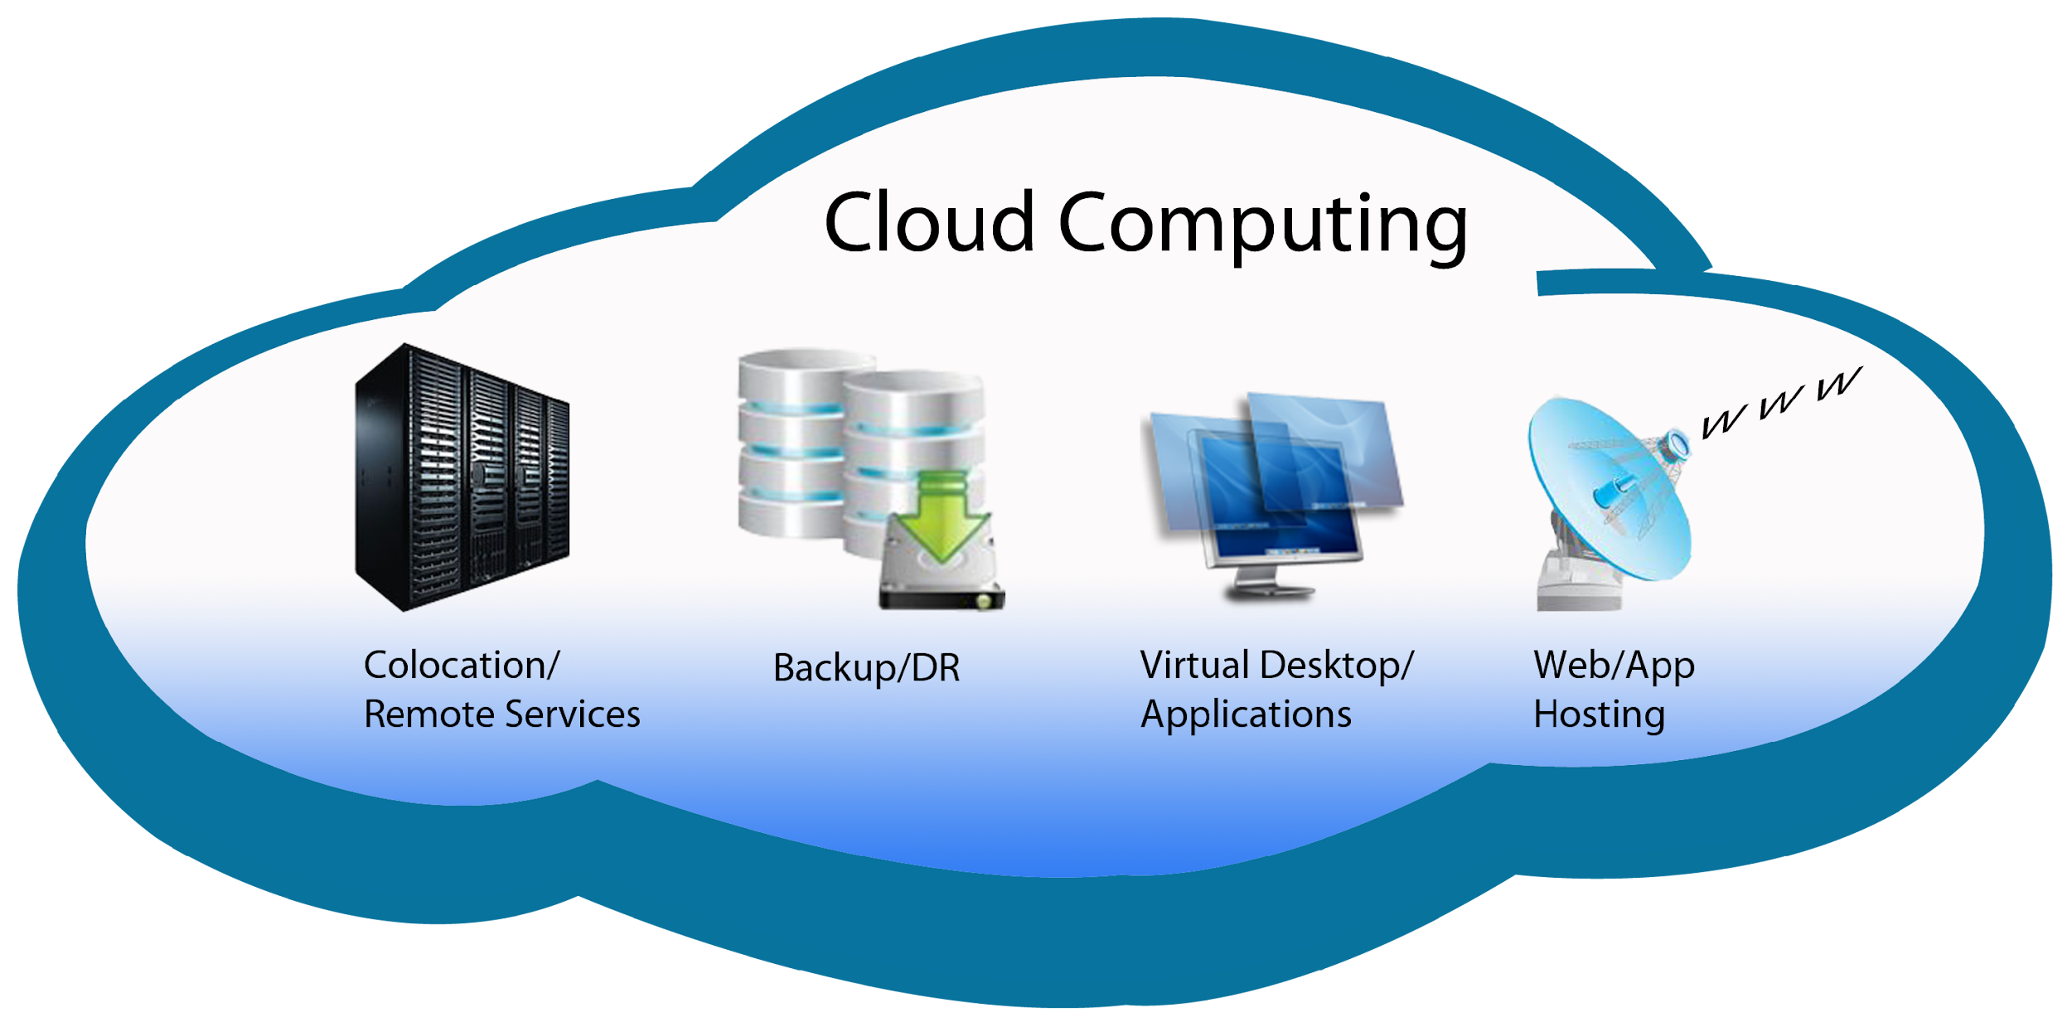
Introduction to cloud computing
What is a cloud computing ?
Definition
On demand delivery of IT resources (compute, storage & memory) via Internet on a pay-as-you-go basis
Cloud Deployment models
Private
Public
Hybrid
Notes:
Cloud Deployment Models
Public Cloud: In a public cloud deployment, the cloud infrastructure is owned, managed, and operated by a third-party cloud service provider. The provider makes computing resources, such as virtual machines, storage, and applications, available to the general public or a large user base over the internet.
Private Cloud: In a private cloud deployment, the cloud infrastructure is dedicated to a single organization. It can be located on-premises within the organization's data center or hosted and managed by a third-party provider. Private clouds offer greater control, customization, and security, making them suitable for organizations with specific compliance, security, or performance requirements.
Hybrid Cloud: A hybrid cloud deployment combines the use of both public and private cloud environments. It allows organizations to leverage the benefits of both models while maintaining the flexibility to move workloads and data between them.

Slide 14
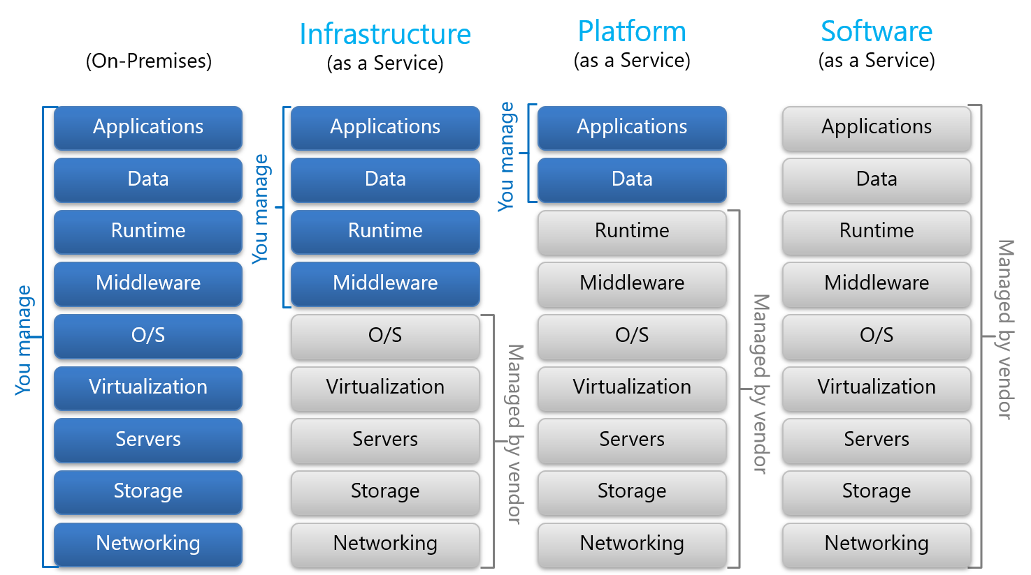
Cloud service models
Infrastructure as a Service (IaaS): Infrastructure as a Service provides virtualized computing resources over the internet.
Platform as a Service (PaaS): Platform as a Service provides a complete development and deployment platform for building and running applications over the internet.
Software as a Service (SaaS): Software as a Service delivers software applications over the internet on a subscription basis. SaaS providers host and manage the entire software application stack, including infrastructure, middleware, and application software.
Notes:
Key Concepts :
IaaS :
Virtualized infrastructure components: Virtual machines, storage, and networks are provided.
User responsibility: Users manage and control the operating systems, middleware, applications, and data.
Scalability and flexibility: Users can dynamically scale resources up or down based on demand.
PaaS :
Pre-configured development platforms: Operating systems, development tools, and runtime environments are provided.
Application-focused: Users focus on application development and deployment rather than infrastructure management.
Automatic scalability: PaaS platforms can automatically scale applications based on demand.
SaaS :
Fully managed applications: The provider manages and maintains the entire application stack.
Web-based access: Users access the application through a web browser or client application.
Pay-as-you-go model: Users pay a subscription fee based on usage or a fixed period.

Slide 15
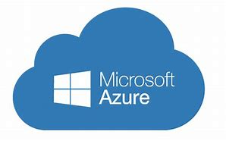
Introduction to Azure Cloud
History of MS-Azure cloud
Windows Azure: On October 27, 2008, Microsoft announced Windows Azure, the initial name for its cloud computing platform.
Windows Azure was positioned as a platform for building, deploying, and managing applications and services in the cloud.
It provided a scalable and flexible infrastructure for hosting various workloads, including web applications, databases, and storage.

Slide 16
Microsoft Azure advantages
Broad Range of Services
Global Presence and Scalability
Hybrid Capabilities
Strong Security and Compliance
Cost Management and Optimization
AI and Machine Learning Capabilities
Strong Community and Support

Slide 17
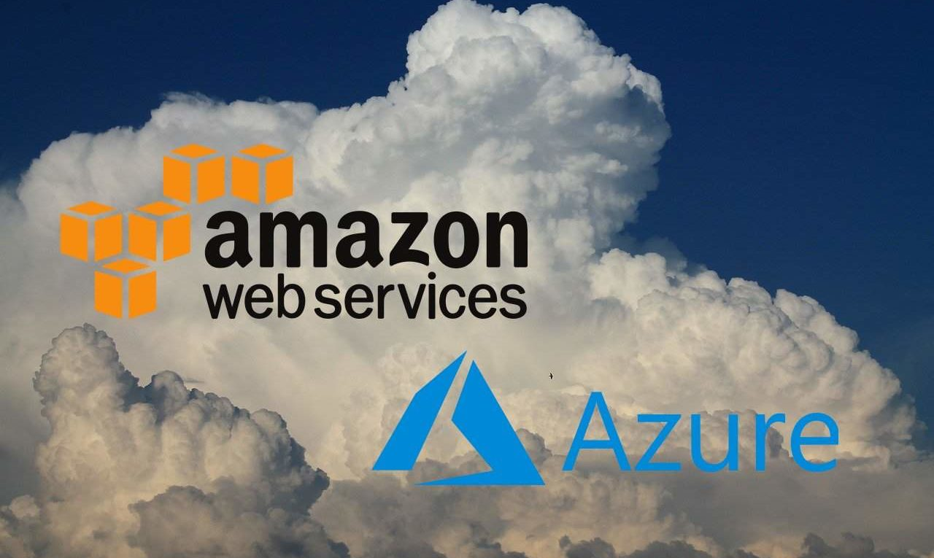
MS-Azure VS AWS
Aspect | Azure | AWS
Market Share | Rapidly growing and strong competitor to AWS | Market leader with a significant market share
Service Offerings | Comprehensive suite of cloud services | Comprehensive suite of cloud services
Global Infrastructure | Global network of data centers in multiple regions | Global network of data centers in multiple regions
Hybrid Cloud Capabilities | Strong focus on hybrid cloud deployments | Provides hybrid cloud capabilities
Integration with Existing Infrastructure | Strong integration with Microsoft products and services | Broad compatibility and integration with various technologies
Pricing and Cost Management | Flexible pricing models with various options | Flexible pricing models with various options
Community and Support | Large and active user community, comprehensive support | Mature community, comprehensive support

Slide 18
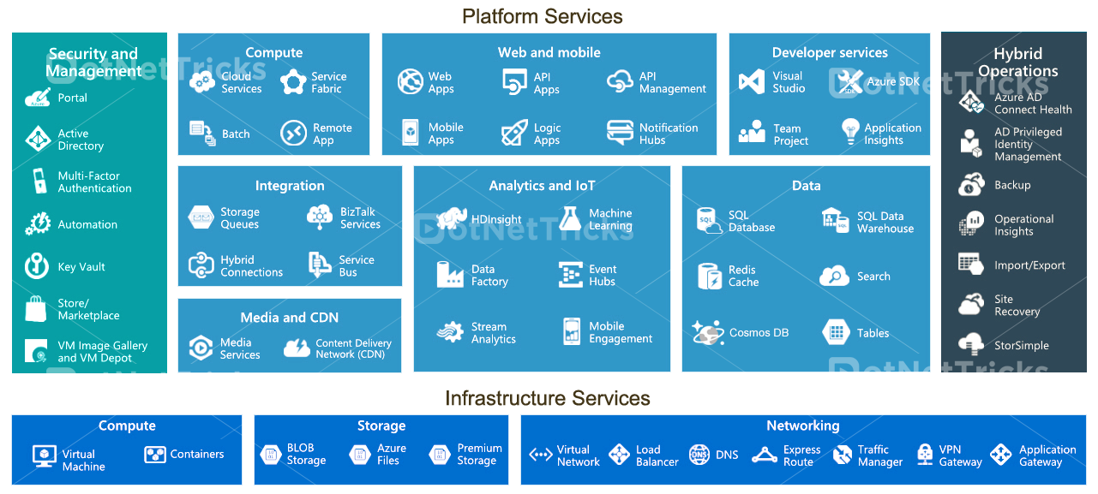
Azure Core services
Azure Compute
Azure Storage
Azure Networking
Azure Database service
Azure Container
Azure Security

Slide 22
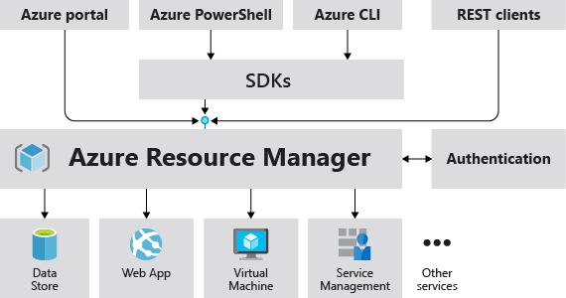
Azure Access methods
Azure Portal
Azure Command-Line Interface (CLI):
Azure PowerShell
Azure Software Development Kits (SDKs)
Notes:
Azure Access methods
Azure Portal: The Azure Portal is a web-based user interface that allows you to manage and interact with your Azure resources. You can access and configure services, monitor resource health and performance, deploy resources, and manage permissions.
Azure Command-Line Interface (CLI): The Azure CLI is a command-line tool that provides a command-line interface for managing Azure resources.
Azure PowerShell: Azure PowerShell is a command-line scripting environment that provides a PowerShell interface for managing Azure resources. It allows you to write scripts and automate Azure tasks using PowerShell cmdlets specifically designed for Azure.
Azure Software Development Kits (SDKs): Azure SDKs are libraries and tools that provide programming language-specific APIs for interacting with Azure services. SDKs are available for popular languages such as .NET, Java, Python, Node.js, and more.

Slide 24
Hands-on
Creating an Azure free account and navigating the Azure portal.
Trainer - Demonstration – Azure Dashboard
Notes:
Duration – 60 minutes
Trainer to demonstrate the Azure Dashboard – 15 minutes
Creating an Azure free account and navigating the Azure portal– 45 minutes

